Slide 1

Javascript Libraries for Web Mapping
Cartographic Experiments and Review
Jesse Fried
Thematic Cartography
April 22, 2021

Slide 2
Goal
Reproduce proportional symbol map that won the class’s map design competition as closely as possible, using several Javascript web mapping libraries
Assess these libraries for their usefulness for good cartographic design

Slide 3




Contenders…

Slide 4
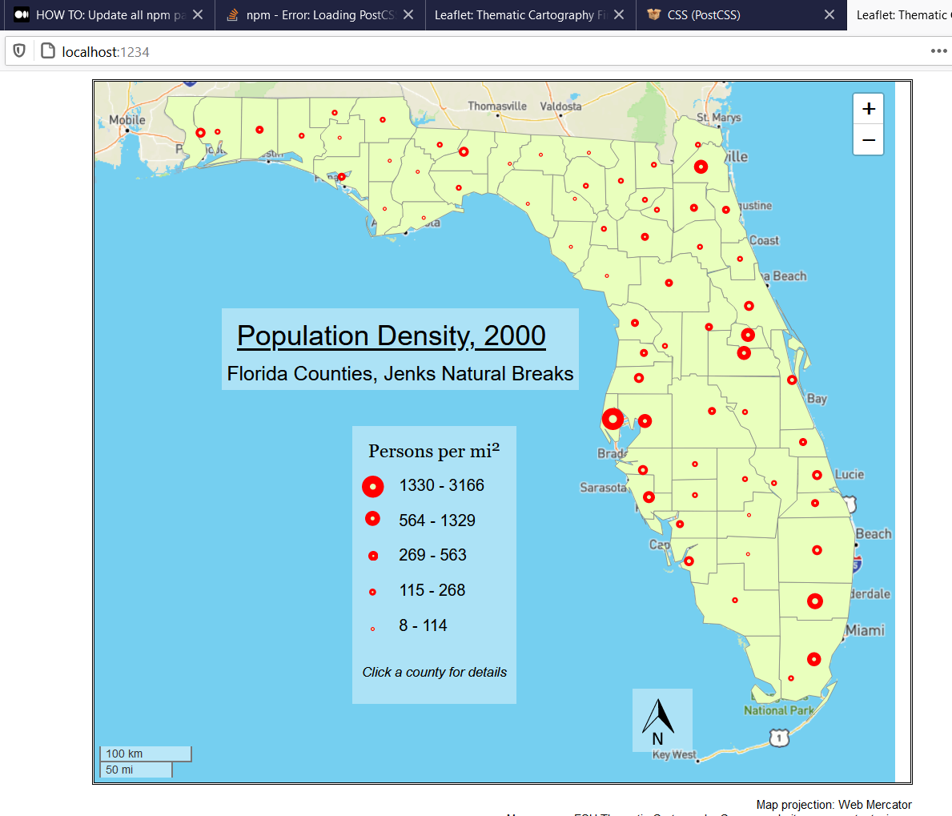

Slide 5
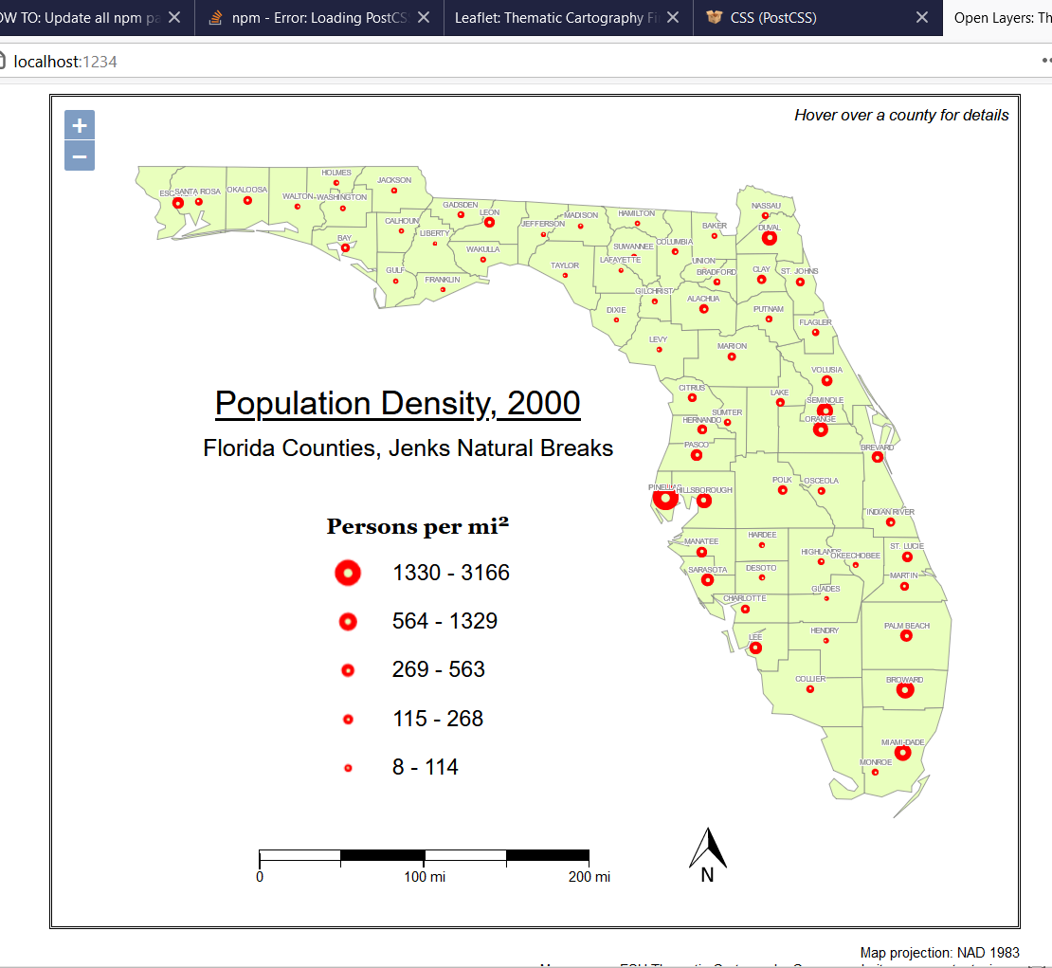

Slide 6
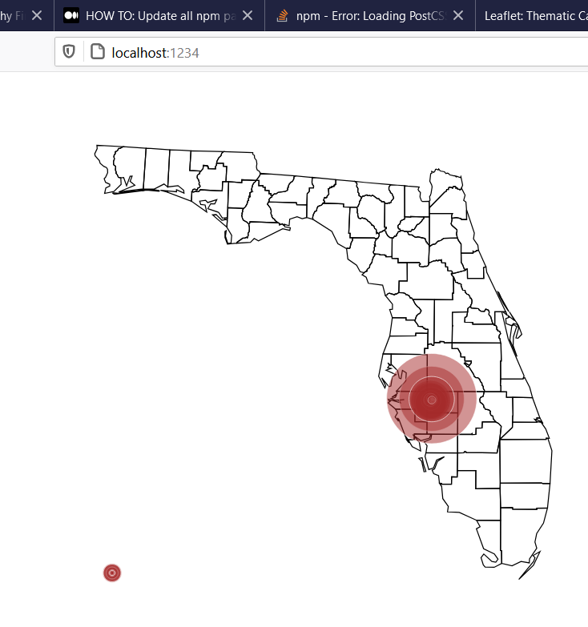
Insufficient time and skills
to complete

Slide 7
Insufficient time to create map,
but studied documentation

Slide 8
Assessment
 | Basemap | Vector Features | Wide support for coordinate systems, projections | Symbology | Legend | Scalebar | Feature labels | North Arrow
Leaflet | Required | SVG/canvas | No | Custom: easy | No | Yes (basic) | Plugin | No
Open Layers | Optional | canvas | Yes | Custom: easy | Plugin | Yes (more flexible) | Yes | No
ArcGIS Javascript API | Optional | canvas | Yes | Built-in | Yes | Yes (basic) | Yes | No
D3 | None | SVG/canvas | Yes | Custom: advanced | No | No | No | No

Slide 9
Overall favorite…
Feature rich, flexible, not too steep of a learning curve
…hope to learn D3 someday though

